Slide 1
Introduction to CNN
Course Code: CSC 4254
Course Title: Computer Vision & Pattern Recognition
Dept. of Computer Science
Faculty of Science and Technology
Lecture No: | 7 | Week No: | 4 | Semester:
Lecturer:

Slide 2
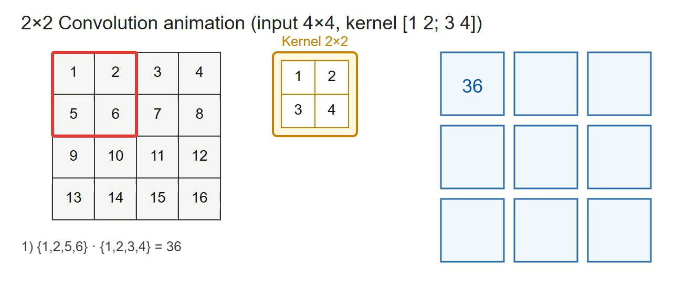
Convolutions and Filters
(click title to access the animation in web)

Slide 3
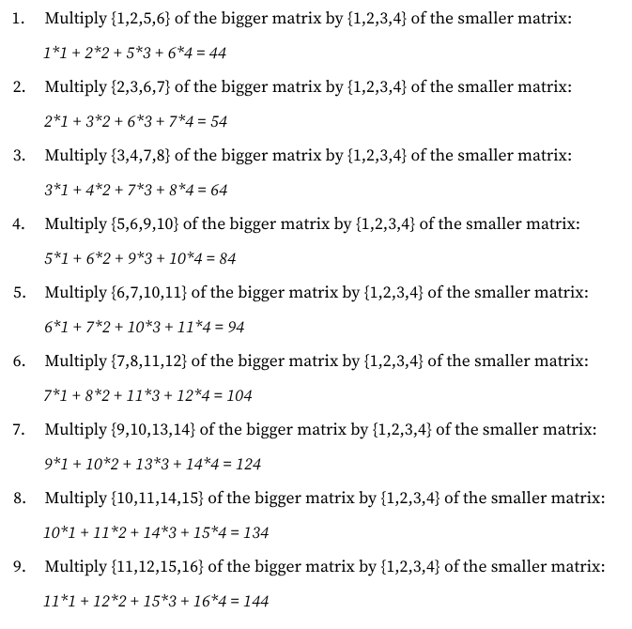
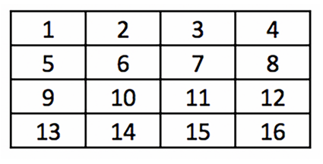
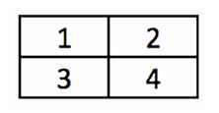
Step by Step Calculation
Matrix A
Matrix B

Slide 4
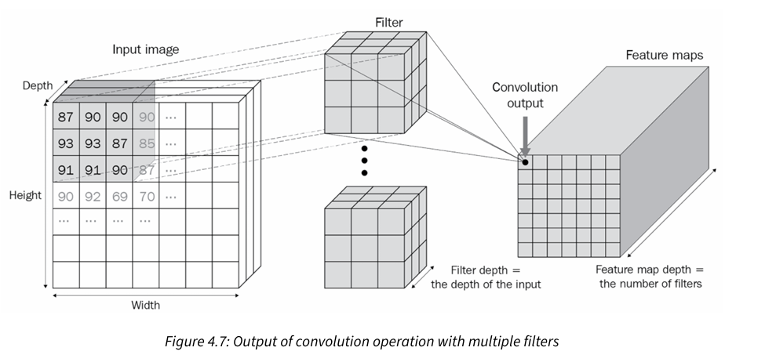
Convolutions and Filters
in a scenario where we are dealing with color images where there are three channels, the filter that is convolving with the original image would also have three channels, resulting in a single scalar output per convolution. Also, if the filters are convolving with an intermediate output – let’s say 64 x 112 x 112 in shape – the filter would have 64 channels to fetch a scalar output. In addition, if there are 512 filters that are convolving with the output that was obtained in the intermediate layer, the output post-convolution with 512 filters would be 512 x 112 x 112 in shape

Slide 5
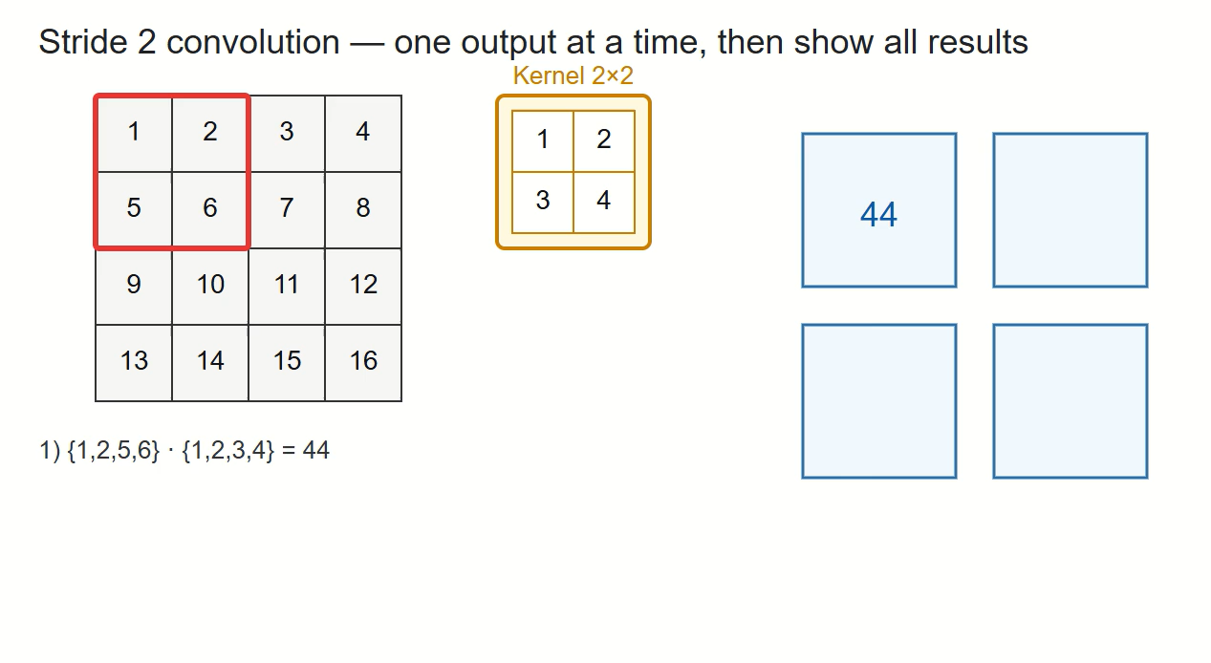
Strides
(click title to access the animation in web)

Slide 6
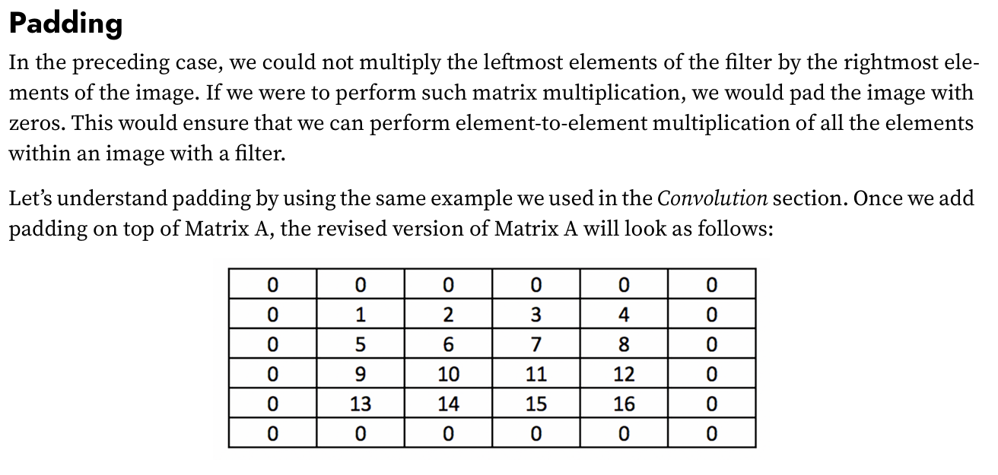
Padding

Slide 7
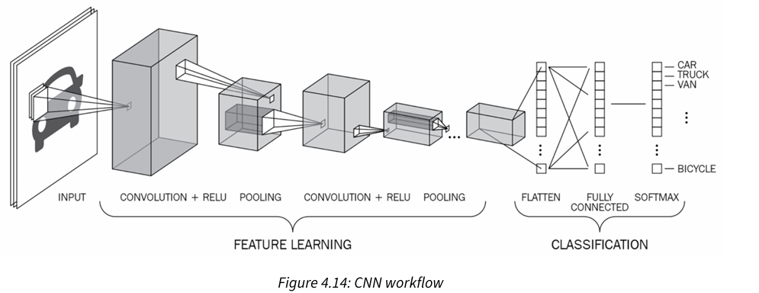
Putting them all together

Slide 8
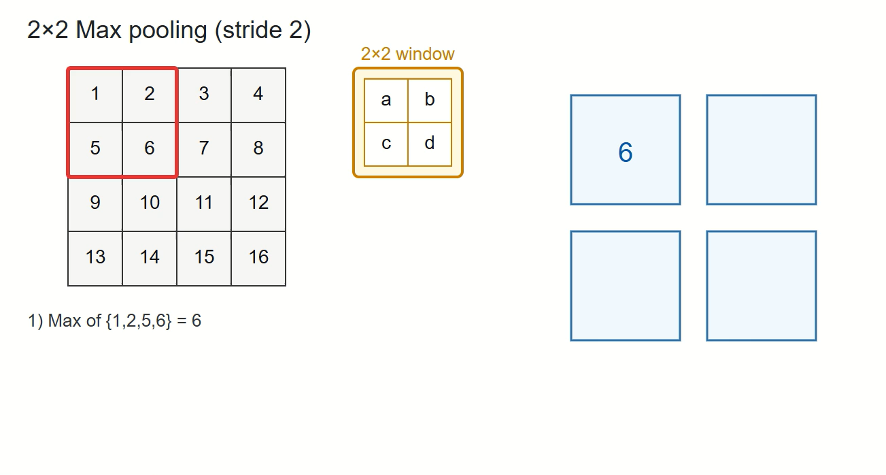
Pooling (Max Pooling)
(click title to access the animation in web)

Slide 9
https://poloclub.github.io/cnn-explainer/#article-convolution
Wang, Z. J., Turko, R., Shaikh, O., Park, H., Das, N., Hohman, F., ... & Chau, D. H. P. (2020). CNN explainer: learning convolutional neural networks with interactive visualization. IEEE Transactions on Visualization and Computer Graphics, 27(2), 1396-1406.

